Slide 1
Ethical Blind Spot: Why Good People Do Bad Things
Jennifer Sawayda
Program Specialist
Anderson School of Management
University of New Mexico
Albuquerque, NM
Notes:
Adapted from Francesca Gino, ”The Science of Compliance,” PPT presentation presented at 21st annual Ethics and Compliance Officer Association conference in Chicago, Illinois on September 25, 2013.

Slide 2
Myth #1
Most misconduct in organizations is done by ‘bad apples’ or rogue employees seeking to take advantage of the situation
  This assumption takes for granted that individual moral values & philosophies are the primary tools used in employee ethical decision making.
  Takeaway, ‘hire good people & there will be no ethical issues’

Slide 3
Reality*
Most individuals see themselves as being ethical.
  In one survey, respondents were asked to rate how ethical they felt they were compared to the rest of the population on a scale of 0 (completely unethical) to 100 (completely ethical)
  The average score was 75
  The majority see themselves as more ethical than their peers
* Max Bazerman & Anne Tenbrunsel (2013) Blind Spots: Why We Fail to Do What's Right and What to Do about It, Princeton University Press.
Notes:
Max H. Bazerman and Ann E. Tenbrunsel, Blind Spots (Princeton, NJ: Princeton University Press, 2011); Ann Tenbrunsel, “Misrepresentation and expectations of misrepresentation in anethical dilemma: The role of incentives and temptation,” Academy of Management
Journal, vol. 41, no. 3 (1998), 330-339.

Slide 4

Question
If most individuals rate themselves as ethical & perceive that they have higher moral values—even more so than their peers—why is misconduct so prevalent?

Slide 5
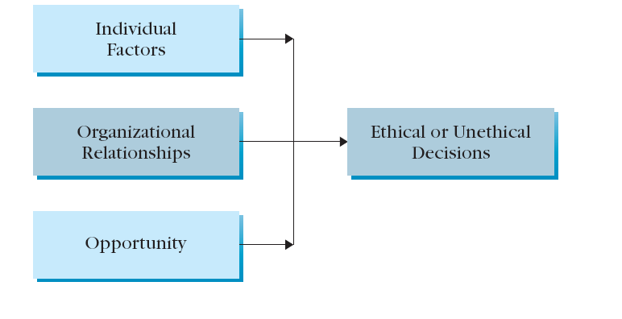
Ethical Decision Making Model*
*O.C. Ferrrell and Larry Gresham (1985) Journal of Marketing.
Notes:
Ferrell & Gresham argue that organizational relationships are the primary contributor to ethical decisions in the workplace. O.C. Ferrell and Larry Gresham (1985) “A Contingency Framework for Understanding Ethical Decision Making in Marketing,” Journal of Markering.
O. C. Ferrell and Larry C. Gresham, “A Contingency Framework for Understanding Ethical Decision-Making in Marketing,” Journal of Marketing, 1985, pp. 87-96.

Slide 6
Theories of Human Behavior
Standard economic model
  Unbounded power, unbounded rationality, & unbounded selfishness
  People will act deceptively if it is in their own self-interest
Employees learn from others in the company
  Social learning theory-people learn behavior by observation, modeling, & interaction with others
  Differential association theory-people learn to behave a certain way based on interaction with intimate groups or role sets
Notes:
Richard H. Thaler and Sendhil Mullainathan, “How Behavioral Economics Differs from Traditional Economics,” Library of Economics and Liberty, http://www.econlib.org/library/Enc/BehavioralEconomics.html
E. Sutherland and D.R. Cressey, Principles of Criminology , 8th ed. (Chicago, IL: Lippencott, 1970).
A. Bandura, Social foundations of thought and action (Englewood Cliffs, NJ: Prentice-Hall, 1986).

Slide 7

Implications
While an employee might desire to be ethical (individual values), social and situational factors in the workplace exert significant pressure on the employee (organizational relationships, opportunity)

Slide 8

Barriers to Ethical Culture*
  Poorly-conceived goals
  Motivational blindness
  Indirect blindness
  The slippery slope
  Overvaluing performance/outcomes
  * Max Bazerman & Anne Tenbrunsel (2013).
Notes:
Francesca Gino, ”The Science of Compliance,” PPT presentation presented at 21st annual Ethics and Compliance Officer Association conference in Chicago, Illinois on September 25, 2013.
Max H. Bazerman and Ann E. Tenbrunsel, “Ethical Breakdowns,” Harvard Business Review, April 2011, http://hbr.org/2011/04/ethical-breakdowns/ar/1.

Slide 9
Poorly-Conceived Goals
Setting ambitious—sometimes unfeasible—goals without considering how these goals will be carried out
  “I don’t care how you make the numbers as long as you make them!”
  Countrywide Financial; Ford Pinto defects; Challenger Explosion

Slide 10
Motivational Blindness
When a conflict of interest exists, employees are encouraged to ignore unethical behavior
  ‘As long as the company is doing all right in the long-run, manipulating this quarter’s numbers won’t make much of a difference.’
  Enron’s Jeffrey Skilling & Ken Lay; Arthur Anderson; Penn State; WalMart & bribery in Mexico

Slide 11
Indirect Blindness
Less of an ability to see actions that indirectly harm others as unethical or wrong
  A sales manager hints to a new salesperson that the best way to sell a controversial drug is to avoid mentioning certain side effects
  Milgram experiments; Nike & child labor
Notes:
Merck sells two small cancer drugs to Ovation. Ovation raises the price dramatically. Despite the fact that it “sold” the drugs, Merck continued to produce them. In other words, Merck produced them but allowed another company to sell them at exorbitant prices.
Francesca Gino, Don A. Moore, and Max H. Bazerman, "See No Evil: Why We Fail to Notice Unethical Behavior," Chap. 10 in Social Decision Making: Social Dilemmas, Social Values, and Ethical Judgments, edited by R. M. Kramer, A. E. Tenbrunsel, and M. H. Bazerman, 241–263. Routledge, 2009.

Slide 12
Slippery Slope
Employees are less likely to notice unethical behavior when it happens gradually, or in increments
  The boiling frog scenario
  Many frauds start out this way: “Just one more time and then we’ll stop,” Weston Smith, former CFO of HealthSouth
Notes:
In a lecture given to the University of New Mexico’s Student Center for the Public Trust, Weston Smith described how he got involved with fraud, convincing himself at first that it was only for a short period and eventually realizing that the fraud was becoming a long-term practice without any end in sight.
Supposedly, this was also the case with Bernard Madoff if his testimony can be trusted.

Slide 13
Overvaluing Performance
The outcomes are more important than what it took to get those outcomes.
The ends justifies the means
  “Getting tips from the inside has doubled our company’s profitability,” The Galleon Group; Diamond Foods

Slide 14
Conclusions
Being aware of social & situational influences in the workplace can prepare us for discovering & resolving ethical issues
Companies can help through:
  Ethics training & codes
  Ethical leadership within the organization
  Controls to limit opportunity for unethical behavior
  An open communication culture encouraging employees to speak up
  Hotlines & anonymous reporting mechanisms

