Slide 1
Daniels Fund Initiative
Ethical IT Use & Protection
Robert Luo
01

Slide 2
Ethical IT Use and Protection Labs
Attacks & Exploits
Cryptography
Evading IDS & Firewalls
Information Gathering
System Hacking
Five Sections Including Ten Hands-on Labs
02

Slide 3
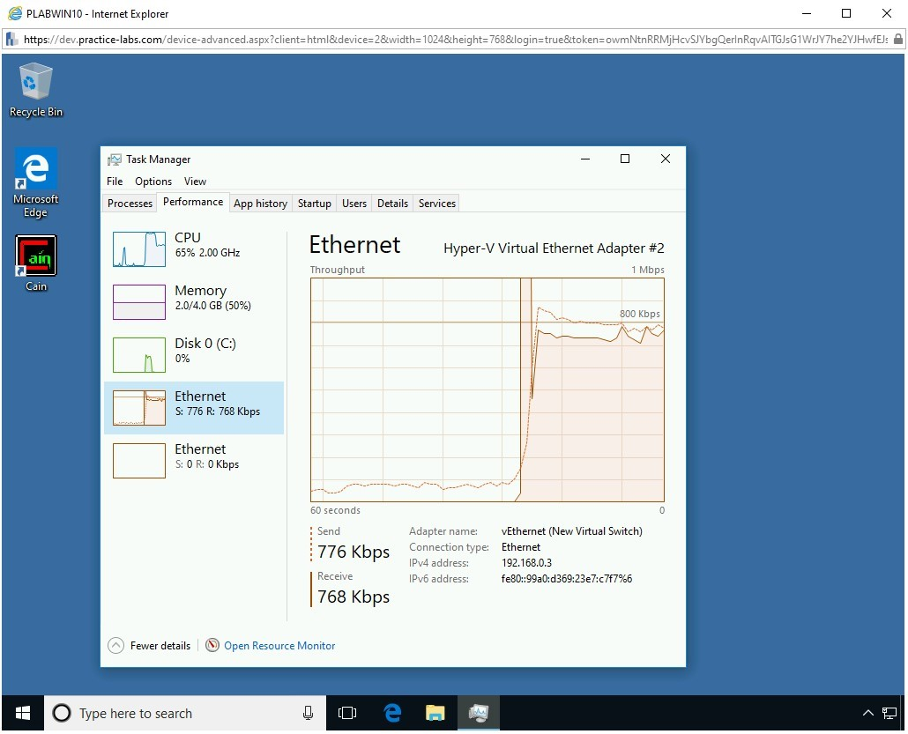
Attacks and Exploits — Denial of Service
A Denial of Service (DoS) attack is conducted using one system to send a high amount of traffic to the target system draining out the system of its resources.
Lab Outcomes
Install & Use Wireshark
Perform SYN Flooding Attack
Perform an ICMP Flood Attack
Perform an SYN Floor Attack Using Metasploit Framework
03
Showing the increased traffic activity

Slide 4
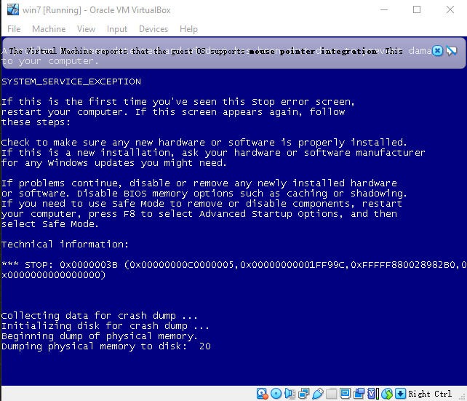
Attacks and Exploits — Distributed Denial of Service
Distributed Denial of Service (DDoS) may use hundreds or thousands (or even more) systems, which are known as zombies or bots, to attack one or more target systems.
Lab Outcomes
Disable Windows Firewall
Enable Remote Desktop
Perform an RDP Attack by MS12-020 Vulnerability
Perform an RDP Attack by BlueKeep Vulnerability
04
Showing a blue screen error and forcing system to restart

Slide 5
Attacks and Exploits — Protection
Various methods can be used to prevent the infrastructure from DoS/DDoS attacks. Some of these methods are:
Use a firewall to filter incoming traffic
Use anti-malware on systems and servers
Use Web Application Firewall for Web application protection
Enable router throttling
Disable unnecessary services
Filter unwanted E-mails
Monitor and audit servers and network regularly
05

Slide 6
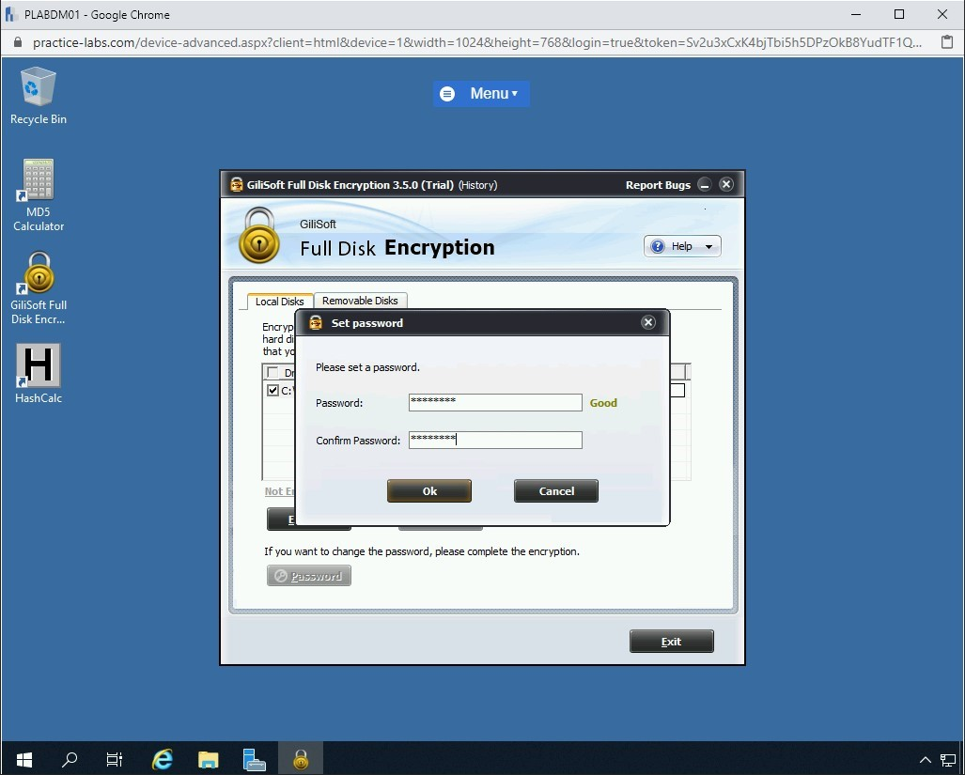
Cryptography — Cryptography
The protection of sensitive information is paramount. There are various cryptography tools available to encrypt and secure the information
Lab Outcomes
Prepare Files & Folders for Encryption
Install and Use Crypt4Free
Use the HashCalc Tool
Use MD5 Calculator
Perform Full Disk Encryption
Typing the password to perform the disk encryption
06

Slide 7
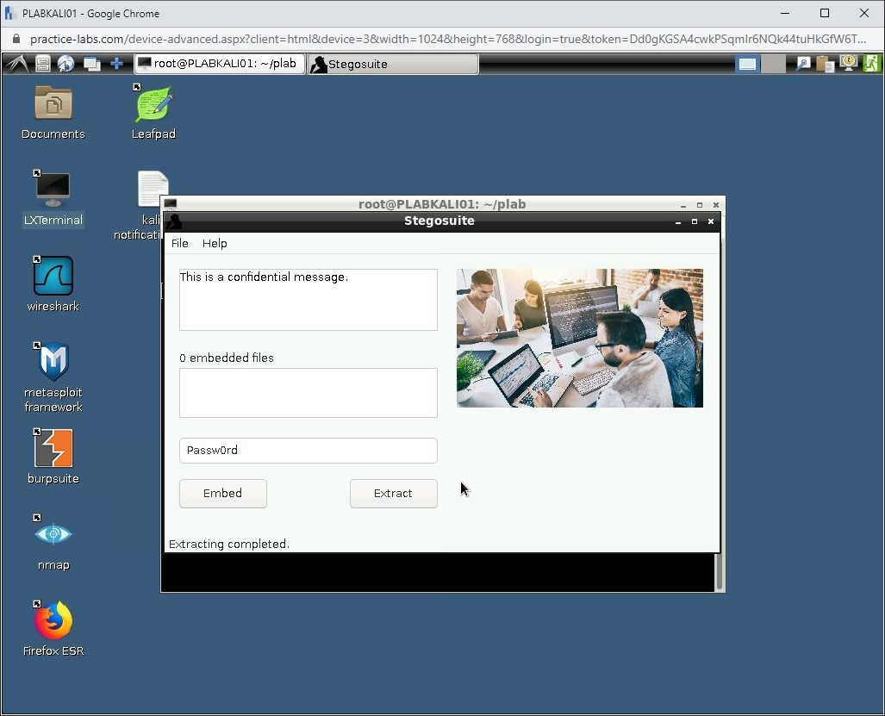
Cryptography — Steganography
Steganography means covered or hidden. It is mainly intended to hide a secret message in a plain message or an image file.
Lab Outcomes
Hide Documents in an Image
Use Steghide and Stegosuite to Hide Data in an Image
Use SilentEye to Hide Information within a File
07
The text string has been extracted with passwords

Slide 8
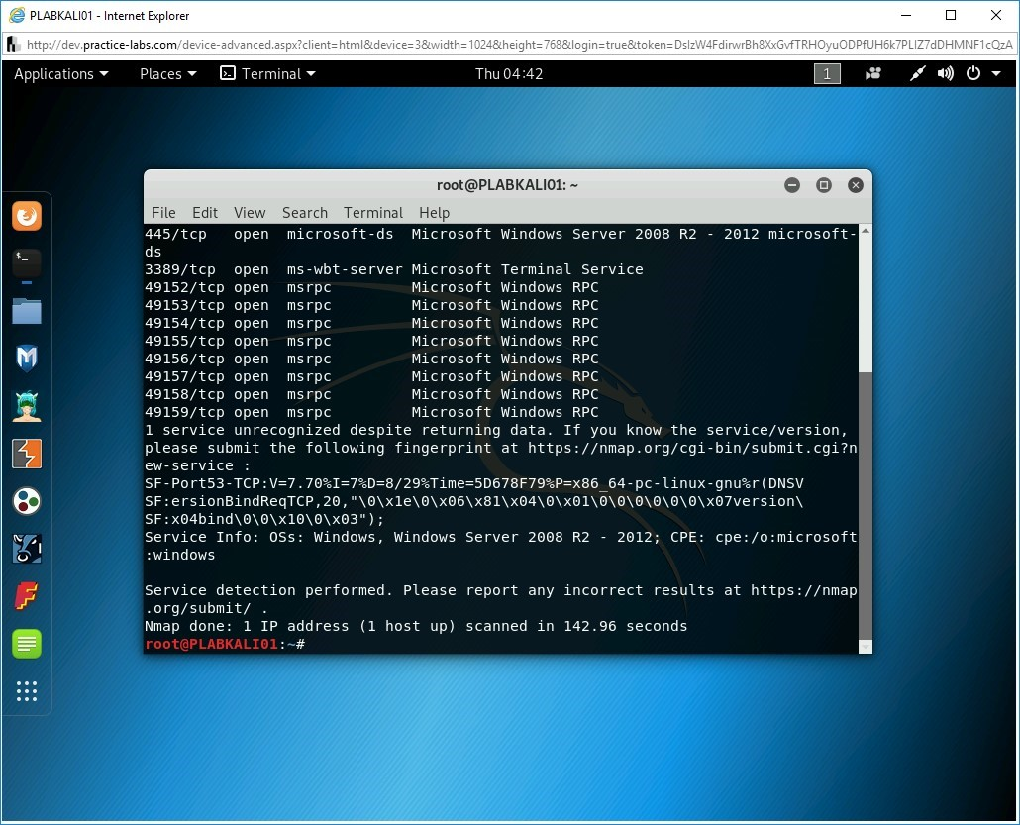
Evading IDS and Firewalls — Enumeration
Enumeration allows attackers to establish an active connection with a target to extract information such as user names, network shares & services, DNS information, etc.
Lab Outcomes
Use SuperScan for NetBIOS Enumeration
Use Hyena for Enumeration
Perform LDAP Enumeration using Softerra LDAP Administrator
Perform SNMP Enumeration using IP Network Browser
08
Listing open ports, running services, and their versions

Slide 9
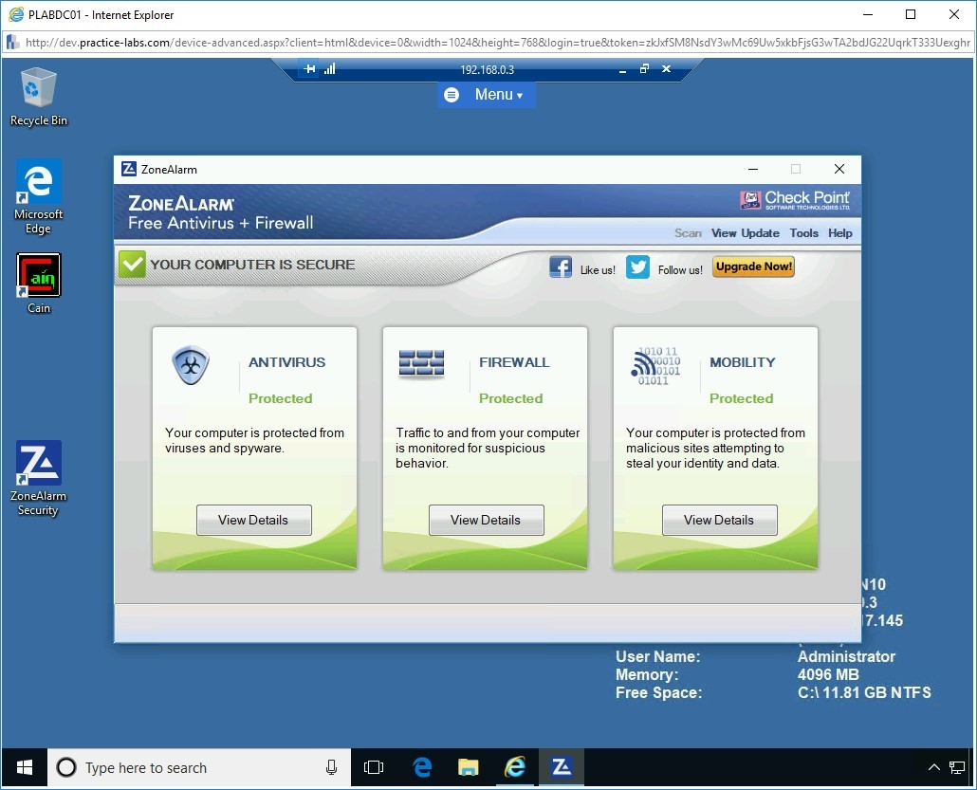
Evading IDS and Firewalls — Evading Firewalls
A firewall is a device that prevents unauthorized access to a host or a network. ZoneAlarm Free Firewall software can be used to meet basic firewall requirements
Lab Outcomes
Verify ZoneAlarm Installation
Manage ZoneAlarm Settings
Configure ZoneAlarm
Update the ZoneAlarm Definitions
Work with ZoneAlarm Logs
09
ZoneAlarm main window

Slide 10
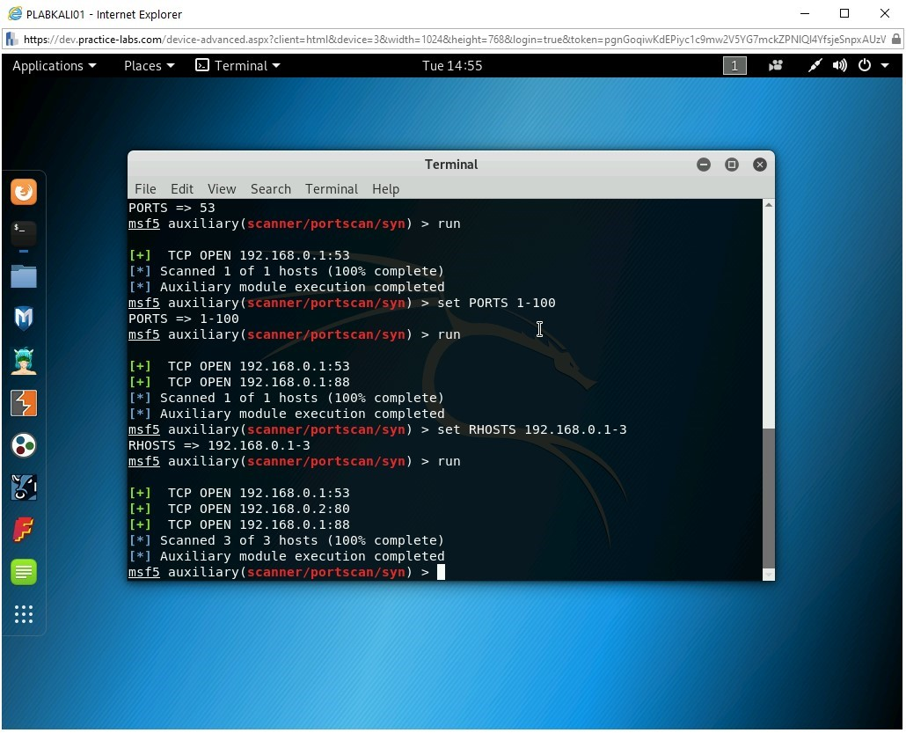
Information Gathering — Scanning Networks
Kali Linux contains various tools that can be used for network scanning. These tools are: Hping3, Netdiscover, Nmap, Fping, Msfconsole, etc.
Lab Outcomes
Use Hping3 for Network Scanning
Use Netdiscover for Scanning the Network
Perform Stealth Scanning Using Nmap
Use fping for Network Scanning
Use Msfconsole to Perform TCP Stealth on a Network
10
Showing the open ports

Slide 11
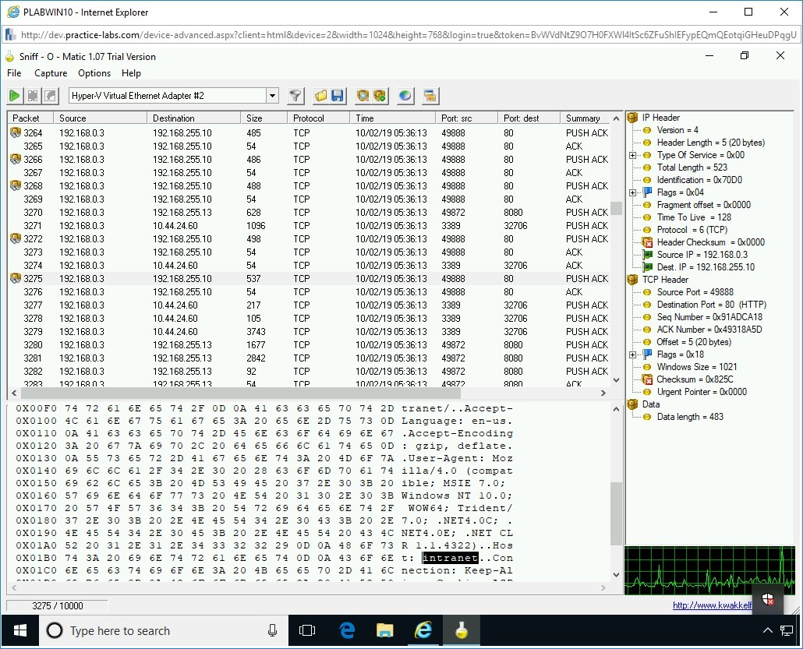
Information Gathering — Sniffing
Sniffing refers to the process in which data packets traveling over a network are captured, and sniffed packets can be reviewed using a tool, such as Wireshark.
Lab Outcomes
Use MAC Address Changer: Change MAC Address
Use SMAC 2.0
Install & Use Wireshark
Use Sniff-O-Matic
11
Showing the details of one packet sniffed

Slide 12
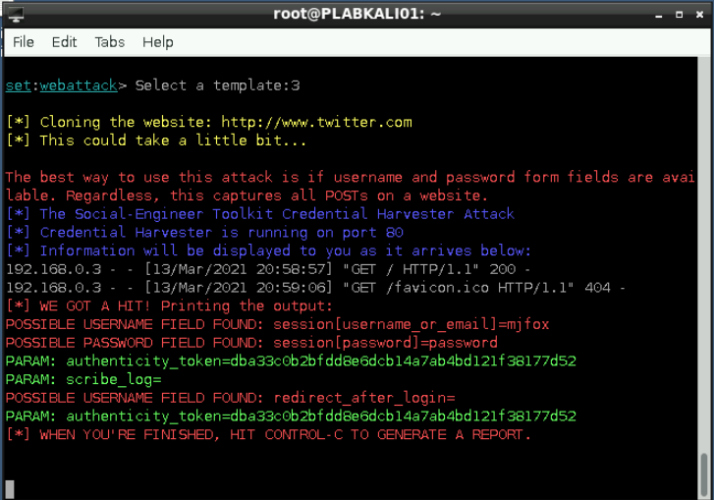
Information Gathering — Social Engineering
Social-Engineer Toolkit is an open-source Python-based toolkit that can be used to perform social engineering attacks, such as email phishing or Web-based attacks.
Lab Outcomes
Create a Malicious Payload
Execute the Payload
Collect Evidence of Compromise on User’s System
Conduct Social Engineering Using a Cloned Website
12
Showing the captured user credentials in the terminal window

Slide 13
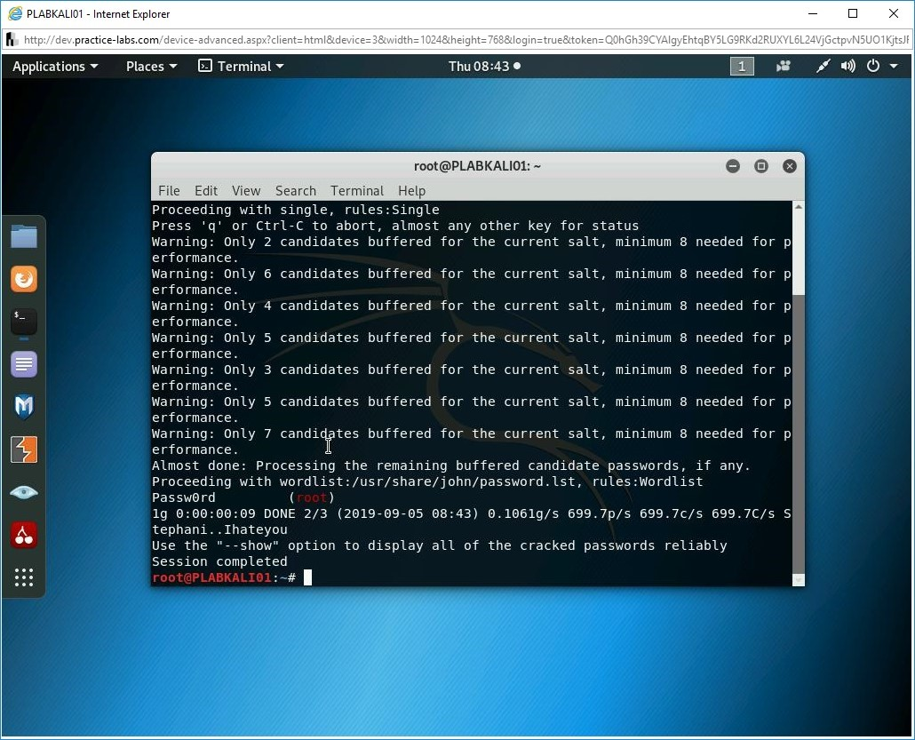
System Hacking — Password Cracking
Password attack is a method to crack a password for a network service or on a system file. Two popular attack types are dictionary attack and brute-force attack.
Lab Outcomes
Crack Linux Passwords
Recover Password Hashes from a Windows SAM File
Crack Configuration File Passwords
Dump Plaintext Passwords
13
Showing the retrieved password for root user

Slide 14
Summary
These hands-on labs can enhance students’ learning experience of ethical IT use & protection, which would help students protect themselves and organizations against information security threats. Also, students are more aware of ethical IT use.
14

Slide 15
Thank you
15

