Slide 1
Ethics of Data Visualization
Based on 1) How Charts Lie by Alberto Cairo, and 2) A Reader on Data Visualization, Chapter 5 Ethics by Michael Correll.

Slide 2
Charts can be misleading
Well-designed charts are empowering.
They can also deceive viewers regardless of whether they are designed with ill-intent or not.
Data visualization has ethical consequences
Ethical thinking is not only about intentions, but also about consequences.

Slide 3
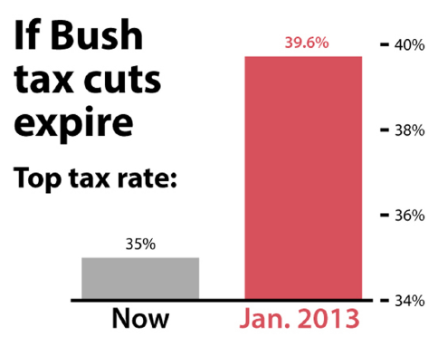
Fox News, 2012
Notes:
Starting a bar chart at a baseline different from zero is the most conspicuous trick to distort your perception of numbers.

Slide 4
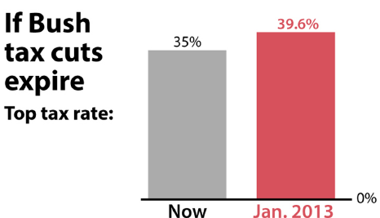
Notes:
The length or height should be proportional to the numbers you try to represent. Therefore, it’s advisable to put the baseline of the chart at zero.

Slide 5
Ethical Principles of Data Visualization
Need to explicitly consider ethical principles when creating and distributing visualizations.
Transparency
Integrity
Accountability

Slide 6
Transparency
The essential goal of data visualization is to bring transparency.
Help users better understand the data and glean new insights.
Visualization needs to be effective.
A graphic that is confusing or misleading is unethical, regardless of intent, since it creates misunderstanding for the audience.
A visualization can have many potential hidden aspects.
The process of data collection, and data preparation
Decisions about the design complexity.
Context of visualization.
Important to achieve open and truthful communications through visualization.
Notes:
There is a growing trend toward permitting viewers of a visualization to access the underlying dataset.

Slide 7
Integrity
Act with honesty when creating and distributing visualizations.

Slide 8
Accountability
Accept responsibility for all decisions
Think about the consequences a visualization can have on viewers when creating and distributing visualizations.
It is important to train yourself to become skillful consumers of charts and graphs—by being aware of your own biases and learning to see what charts and graphs don’t necessarily show.
This skill termed “graphicacy” is the foundation for becoming ethical creators and responsible purveyors of data visualizations.
Notes:
Misinterpretation could happen to everybody.
We must learn how charts can lie to ethical chart creators and purveyors.

Slide 9
How Charts Lie?
Poor design or labeling.
Display insufficient information or too much information
Display wrong or dubious information
Not clearly communicate uncertainty
Suggest misleading patterns or pander to pre-existing prejudices

Slide 10
How Charts Lie?
Poor design or labeling.
Display insufficient information or too much information
Display wrong or dubious information
Not clearly communicate uncertainty
Suggest misleading patterns or pander to pre-existing prejudices

Slide 11
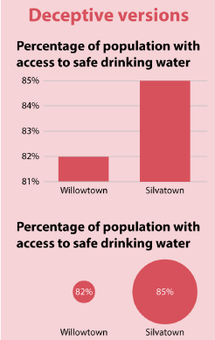
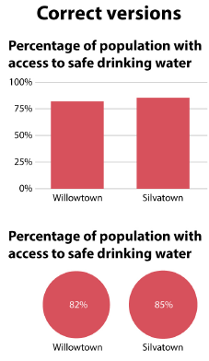
The size of the symbols is not proportional to the data.

Slide 12
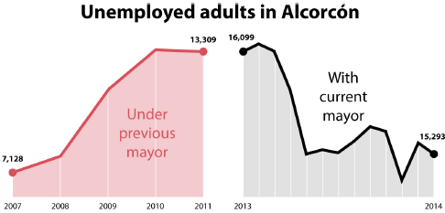
Created by the Spanish city of Alcorcon in 2014 to celebrate the success of the current Mayor in increasing employment.
Distorted both vertical and horizontal scales.
Notes:
Both vertical and horizontal scales are wrong. The two charts are on the different vertical scale. The left chart displays yearly data while the right one displays monthly data.

Slide 13
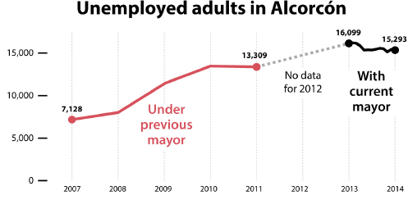

Slide 14
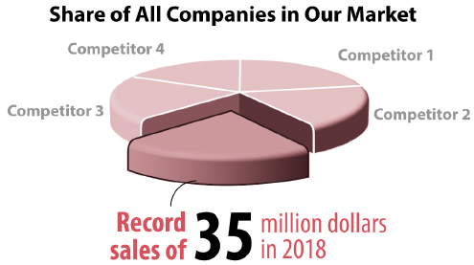
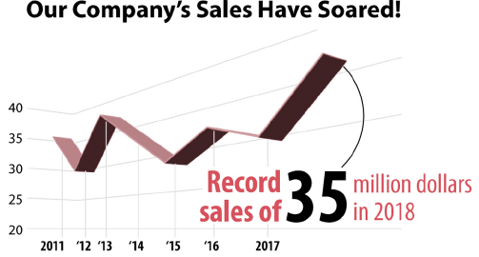
Notes:
Three dimensional charts look fancy but could miserably bias viewers. You can easily exaggerate the performance of a company by choosing convenient orders or angles. For example, the chart on the upper left corner shows our company on the front and competitors in the distance. The bar representing our company will appear tallest. Actually, competitor 1 is slightly better. The sales peaked in 2013 instead of 2018.

Slide 15
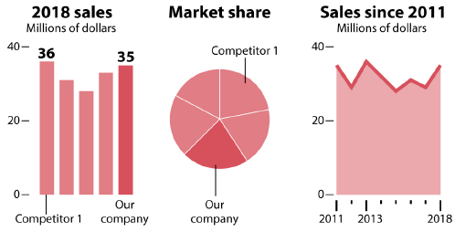

Slide 16
How Charts Lie?
Poor design or labeling.
Display insufficient information or too much information
Display wrong or dubious information
Not clearly communicate uncertainty
Suggest misleading patterns or pander to pre-existing prejudices
Notes:
Some may only display part of the data to support the story they want to deliver.

Slide 17
By Paul Krugman, a columnist for the New York Times
Notes:
Chart can be misleading if the part of the data is not used.
Trump mentioned a supposedly sharp increase of violent crime in the United States, particularly murders.
Nobel Prize winner Paul Krugman, a columnist for the New York Times, pointed out in 2018 that Trump was inventing a problem that doesn’t exist. Many of our big cities have seen a dramatic decline in violent crime.
Both perspectives are misleading. It is true that the murder rate today is way lower than it was thirty years ago. The long-term trend is decreasing rate. But, there is some increase in recent several years.

Slide 18
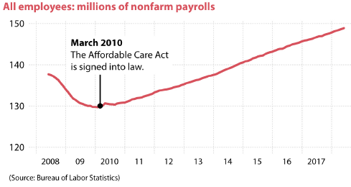
Does the pattern suggests that Affordable Care Act improve job market?
Be cautious to draw a conclusion solely based on a chart. Some other events may contribute to the improvement of job market. Obama’s stimulus package – The American Recovery and Reinvestment Act– was introduced in February 2009.

Slide 19
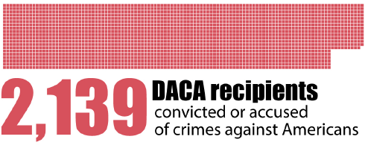
From Breitbart News in September 2017.
A single number is often meaningless without being put into context.

Slide 20
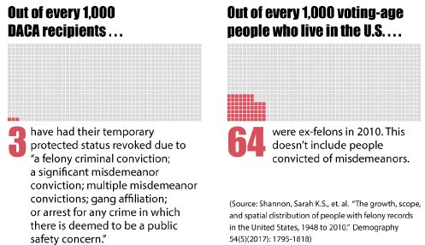
Notes:
To correctly understand this statement, we need to have additional information such as the total number of DACA recipients and the proportion of people who are convicted or accused of crimes in the general US population.
There are more than 800,000 DACA recipients. If we divide 2139 by 800,000, we get the proportion of DACA recipients who are convicted or accused of crime. It is only 0.3%. These crimes include not only serious crimes but only misdemeanors.
It is much lower than the proportion of people who commit serious crimes in the generate population.

Slide 21
Too much data or too complex chart can also cause misunderstanding.
Notes:
On the other hand, a chart displaying too much information may also confuse viewers. A good visualization can be understood easily and intuitively.

Slide 22
How Charts Lie?
Poor design or labeling.
Display insufficient information or too much information
Display wrong or dubious information
Not clearly communicate uncertainty
Suggest misleading patterns or pander to pre-existing prejudices
Notes:
A chart must be based on reliable data in order to be trustworthy.

Slide 23
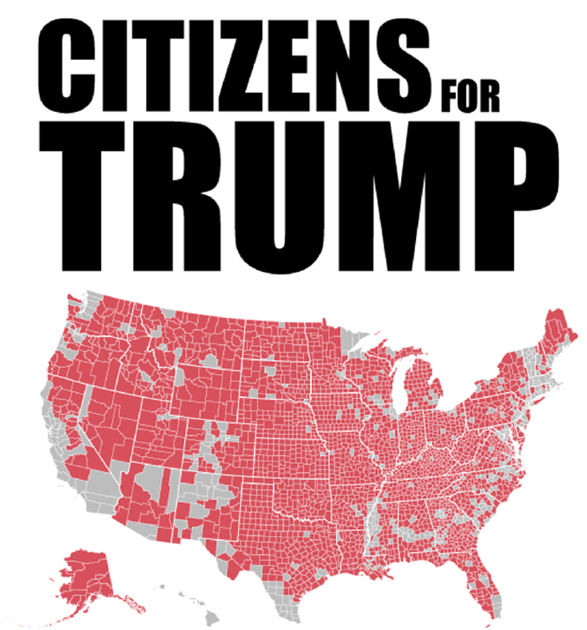
2016 Election
Notes:
The title does not match the map. The map reflects the counties voted for Trump instead of the number of citizens in 2016. Trump won in many large but sparsely populated counties while Clinton won many small in area but densely populated counties.

Slide 24
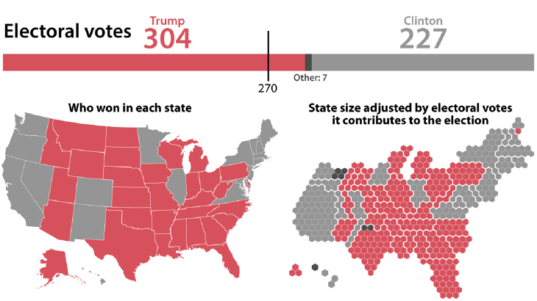
2016 Election
Notes:
In US, the result of presidential election is determined by the number of electoral votes won by each of the two candidates instead of the size of the territory or the number of voters.

Slide 25
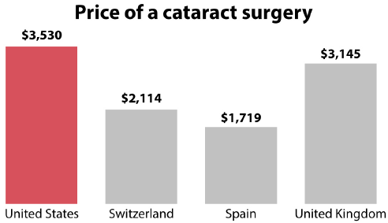
Dubious Data
From news website Vox on July 19, 2016.
The data is from a report by the International Federation of Health Plans (IFHP). Prices for the United States reflect prices negotiated and paid to health care providers. But prices data for other countries are from only one private health plan in each country.
Charts alone rarely prove anything. Need to check the source of a chart and data before further sharing the chart.
Notes:
Be cautious if the chart creator does not mention the sources of the data. Transparency regarding data source is a sign of appropriate standards.

Slide 26
How Charts Lie?
Poor design or labeling.
Display insufficient information or too much information
Display wrong or dubious information
Not clearly communicate uncertainty
Suggest misleading patterns or pander to pre-existing prejudices
Notes:
Data often has uncertainty. Based on the transparency principle, charts need to properly communicate such uncertainty to avoid misleading viewers. It is important for us to learn how to correctly interpret charts with uncertainty information and create such kind of charts. For example, when we try to estimate the value of one variable based on the value of another variable. We want to provide the 95% confidence interval to let chart viewer know about the extent of uncertainty in our estimate.

Slide 27
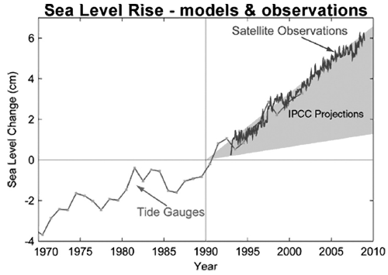
Forecast of seal level rise by the Intergovernmental Panel of Climate Change (IPCC) in 1990. The grey band is the range of forecasts. According to IPCC, sea level could rise roughly between 1.5 and 6.5cm by 2010.

Slide 28
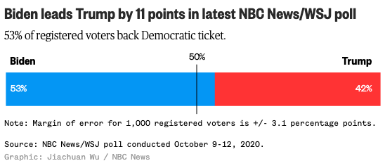
Notes:
The error margin in the above chart reflects the extent of uncertainty in the poll result. Typically it is reported at 95% confidence level.

Slide 29
How Charts Lie?
Poor design or labeling.
Display insufficient information or too much information
Display wrong or dubious information
Not clearly communicate uncertainty
Suggest misleading patterns or pander to pre-existing prejudices
Notes:
Even if a chart is well designed, we may still see patterns that actually do not exist. Other factors not shown in the chart may cause the misleading patterns. We need to train ourselves to seek other explanations for patterns shown in the chart.
In addition, as human beings, we tend to understand charts in a way to reinforce our opinions and prejudices. We come up with assumptions and opinions, and then we unconsciously seek information to reinforce or persuade other people of the rightness of our opinions. This is called confirmation bias. So, even the same chart can be interpreted differently. Being aware of personal biases and learning to see what charts and graphs don’t necessarily show.

Slide 30
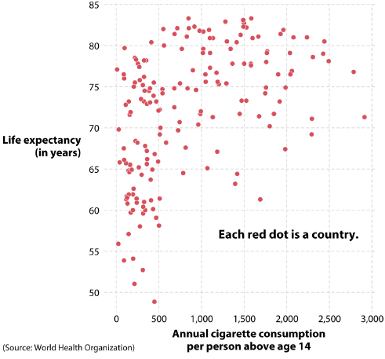
It is wrong to claim that “The more cigarettes we consume, the longer we live”.
Be aware of several challenges in chart reading: the relationship between correlation and causation, the role of amalgamation paradoxes, and the ecological fallacy.
Notes:
The spurious positive association between cigarette consumption and life expectancy at a country-by-country level does not imply causation. Correlation is not equal to causation. Other factors such as affluence may be the cause. People in wealthier countries can afford to buy more cigarettes. They also tend to live longer due to access to better diets and health care.
Amalgamation paradoxes can happen due to different ways of aggregating or subsetting the data. The pattern we observe here may disappear if we use different subsets of the data.
The ecological fallacy can happen when we try to infer about individuals based on the characteristics of the groups they belong to. We cannot use this chart to infer that a person who consumes 2500 cigarette per year will have a life expectancy of 80 years. If the goal is to infer about individuals, country-level chart is not appropriate.

Slide 31
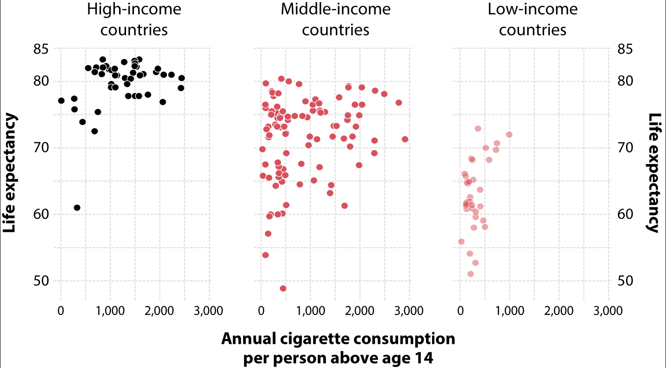
Notes:
The pattern becomes weaker.

Slide 32
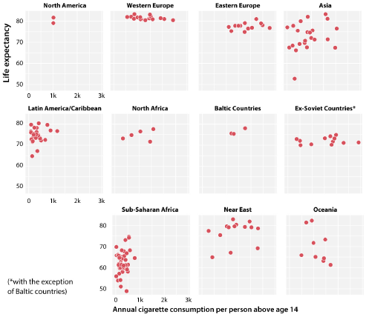

Slide 33
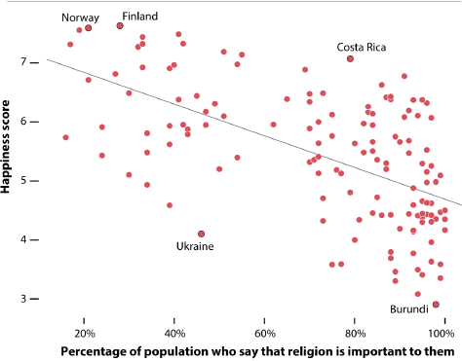
The level of religious commitment is inversely associated with happiness. However, we cannot claim that increasing religiosity leads to lower happiness. The inverse causality may be true.
Notes:
For people in countries with low happiness score, they may be more likely to rely on religion to seek comfort.

Slide 34
Conclusions
Charts have ethical consequences.
Due to the wide use of social media, we can all be content generator and reach many users.
It is a civic responsibility to avoid spreading misleading charts to build healthy information consumption environment.
Testing your charts on other people is essential.

