Slide 1
Ethical Implications of Social Media Use in Organizations
Jennifer Sawayda
Program Specialist
Anderson School of Management
University of New Mexico
Albuquerque, NM
Notes:
A major source used for this presentation is Joe Hair, “Risky business: managing corporate and personal use of social media,” PPT presentation presented at 21st annual Ethics and Compliance Officer Association conference in Chicago, Illinois on September 24, 2013.

Slide 2
Consequences of Organizational Social Media Misuse
Twitter and CFO Postings Cost CFO His Job
PG&E may be fined over former employee’s spying
Peyton Manning Tip: Waiter Fired for Revealing Generous Gratuity
P&G Bans Use of Pandora, Netflix for Employees
For Angry Employees, Legal Cover for Rants
Notes:
Rachel Emma Silverman, “Facebook an Twitter Postings Cost CFO His Job,” The Wall Street Journal, May 14, 2012, http://online.wsj.com/news/articles/SB10001424052702303505504577404542168061590. CFO of fashion retailer Francesa’s Holdings was fired for “improperly communicating company information over social media.” Even implications of financial matters can alert stakeholders about the inner workings of the firm. While workers have certain rights regarding discussing their jobs on social media, mentioning anything that could qualify as non-confidential information can be a serious violation of social media and confidentiality policies.
David R. Baker, “PG&E may be fined over former executive's spying,” SF Gate, April 26, 2012, http://www.sfgate.com/business/article/PG-E-may-be-fined-over-former-executive-s-spying-3510989.php. Former senior director of Pacific Gas & Electric’s Smartmeter installation program used an alias to disguise himself so he could join an online discussion group of activists opposed to wireless meters. He didn’t realize that his real name appeared next to his email address. He admitted “spying” on the group after being confronted by reporters after the group’s moderator recognized him. He was later terminated from the company. The company stated that the director’s actions did not align with the company’s core values and that all employees are expected to be transparent and play fairly in their social media communications. However, it has been suggested that the director had informed other company officials and even the legal department, exposing PG&E to fines.
Payton Manning Tip: Waiter Fired for Revealing Generous Gratuity from Ex-Colts Star,” Huffington Post, March 8, 2012, http://www.huffingtonpost.com/2012/03/08/peyton-manning-tip-waiter-receipt-fired_n_1333674.html. A waiter posted a photograph on Facebook of Payton Manning’s receipt to reveal what a generous tipper the ex-Colts star is. The waiter was fired from his job as he was considered to have infringed on Payton Manning’s privacy. The owner of the restaurant apologized to Manning and has stared the restaurant’s commitment toward protecting the privacy of the celebrities that eat there.
Jack Neff, “P&G Bans Use of Pandora, Netflix for Employees,” Advertising Age, April 3, 2012, http://adage.com/article/digital/p-g-bans-pandora-netflix-employees/233890/. Procter & Gamble realized that many of its employees were using social networking sites like Facebook, Pandora, and YouTube during work hours. This not only contributed to wasted time, but it also used up important bandwidth other employees need to do their work. P&G’s problem is that the company often uses Facebook and YouTube for marketing purposes, so it could not ban those social networks. Instead, it opted to ban access to Pandora and Netflix because these sites are “not business-critical.”
Melanie Trottman, “For Angry Employees, Legal Cover for Rants,” The Wall Street Journal, December 2, 2011, http://online.wsj.com/news/articles/SB10001424052970203710704577049822809710332. Workers fired or disciplined for things they posted on social media sites during their off hours have legal recourse. Employees are using the National Labor Relations Act of 1935 to argue that complaining about certain working conditions such as pay among private-sector employees is protected. In going over complaints from people saying they were unjustly fired for social media postings, the National Labor Relations Board determined that half the complaints did merit the agency to intervene and examine the cases. For instance, one person who called her boss a “scumbag” on Facebook was deemed to have been wrongfully fired. However, comments that could be perceived as threats are not protected, whether the consumer is serious or not. Therefore, it is still important that employees exert caution when posting about their companies.

Slide 3
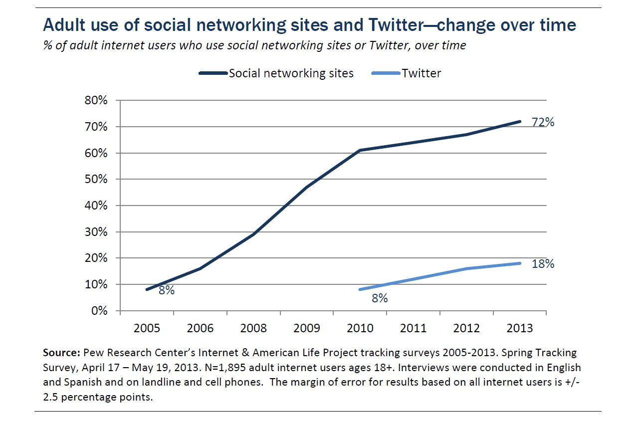
Adult Use of Social Networking Sites
Notes:
72% of online adults use social media sites.

Slide 4
Social Media Facts
Organizational use of social media: 76% (Retail/Wholesale), 74% (Business services/Communications/Finance/Insurance), 72% (Hospitality/Cultural/Rec Services)
64% of employees say they waste time at work each day; social media usage is one of the top time wasters at 14%
Those who spend 30% or more of work time on social media are four times more likely to experience pressure to compromise company values and standards
These active social networkers constitute approximately 11% of employees
Notes:
Going Social, KPMG International, 2011, http://www.kpmg.com/ES/es/ActualidadyNovedades/ArticulosyPublicaciones/Documents/Going-Social.pdf
“2013 Wasting Time at Work Survey,” SF Gate, July 28, 2013, http://www.sfgate.com/jobs/salary/article/2013-Wasting-Time-at-Work-Survey-4374026.php.
Ethics Resource Center, 2011 National Business Ethics Survey®: Workplace Ethics in Transition (Arlington, VA: Ethics Resource Center, 2012), pp. 30-31.

Slide 5
Ways that Social Media Can Benefit Business
Market research
  Understand consumer opinions and preferences
Communication with stakeholders
  Answer customer concerns
  Engage in dialogue with consumers
Promotion
  Advertisements and company updates through social media
  Viral marketing
Employee engagement
  Allow employees to communicate with consumers over social networks
  Internal social networks like Yammer can help employees to communicate with each other

Slide 6
Benefits vs. Costs
According to KPMG survey, respondents noted the following risk areas regarding social media misuse in the workplace: bandwidth (46%), time wasting (35%), malware exposure (49%), confidential information (22%), and negative representation of company (19%)
However, organizational social media use has contributed to relationship building, job satisfaction, productivity gains, wider knowledge pools, and more
For many companies, the benefits of social media use outweigh the risk areas
Notes:
KPMG survey of 1170 managers, Going Social, KPMG International, 2011, http://www.kpmg.com/ES/es/ActualidadyNovedades/ArticulosyPublicaciones/Documents/Going-Social.pdf
Joe Hair, “Risky business: managing corporate and personal use of social media,” PPT presentation presented at 21st annual Ethics and Compliance Officer Association conference in Chicago, Illinois on September 24, 2013.

Slide 7
Impact of Social Media on Companies and Employees
Workers expect access to social media sites
  Millennials expect social media to be available
  Banning social media sites can make employees feel the company doesn’t trust them
Gray area between the employee, the company, and external activities
More interconnected world
Less privacy and more risks that work activities will be discussed

Slide 8
Major Risks
Work effectiveness/productivity
Reputation damage
Information protection
Legal violations
Notes:
11% of employees qualify as avid social networkers spending 30% or more of their workday on social networking sites—resulting in lost productivity. In addition to employees sharing sensitive information on their social networking sites, hacking is also a real threat. The more company information out there on social networking sites, the more damaging hacking can be.
Employees choosing to rant about a company or supervisor could harm the company’s reputation.
It is much easier for employees to inadvertently release confidential information to the public (such as the former CFO of Francesca Holdings) or infringe on others privacy (waiter of Payton Manning).
Legal violations on the company’s part could include firing an employee unjustly due to his or her social media comments. However, company might also get in trouble if information about the firm is released that is not public and/or if the company had any knowledge that an employee was using social media in a deceptive, unethical, or illegal way (PG&E).
Joe Hair, “Risky business: managing corporate and personal use of social media,” PPT presentation presented at 21st annual Ethics and Compliance Officer Association conference in Chicago, Illinois on September 24, 2013.
Ethics Resource Center, 2011 National Business Ethics Survey®: Workplace Ethics in Transition (Arlington, VA: Ethics Resource Center, 2012), pp. 30-31.

Slide 9
Guarding Against Social Media Risks
To guard against social media risks, business should develop:
  Guidelines dictating acceptable use of social media
    Internal use of social media and external use
  Training on appropriate social media use, including employee rights and risks
  Rules and guidelines to guide employees when they use social media to interact with customers
  Clear policies dealing with removal of material on company sites that is deemed inappropriate
Notes:
Internal guidelines should specify how employees can use social media in the workplace, including acceptable use of company equipment and ability of company to monitor workplace postings. External guidelines involves marketing and communication on sponsored social media sites and should deal with reputation management, crisis management, and how the company is able to use data gleaned from social media sites. (Enforcement of this policy could have helped in the PG&E “spying” situation in which the director was using deception to gather information, a clear violation of company policies.)

Slide 10
Monitoring Employee Postings
Should a company monitor social media postings in the workplace?
  While this is permitted and could even be advantageous for the company, it should inform employees of the company’s right to monitor workforce postings so that employees are aware

Slide 11
Conclusion
Social media can be a great way for companies to conduct market research, communicate with employees, promote company products, and engage consumers
  Beneficial to HR and marketing
However, misuse of social media can easily turn into a nightmare.
  Privacy
  Reputation
  Legal implications
  Employee rants
Rather than banning social media use outright and losing a competitive advantage, businesses should have policies and monitoring systems in place to determine appropriate use of social media in the organization

