Slide 1
Pirated Software:
A Global Epidemic
Jennifer Sawayda
Program Specialist
Anderson School of Management
University of New Mexico
Albuquerque, NM
Notes:
A major source used for this presentation is Aaron Baese (Siemens) and Anne Kelly (Microsoft), “Software Piracy: As Harmful as Bribery and Other Forms of Corruption, PPT presentation presented at 21st annual Ethics and Compliance Officer Association conference in Chicago, Illinois on September 25, 2013.

Slide 2
What is Software Piracy?
Unlicensed use or distribution of software
Three types of software piracy:
  Cracked software piracy: pirated software downloaded from unauthorized websites
  Counterfeit: fake software copied from the original and distributed
  Overuse of authorized software: occurs when an individual overuses authentic software beyond the license agreement

Slide 3
Examples
An individual goes onto a warez site and downloads pirated software
  IMPORTANT TERM: Warez refers to pirated materials, and the warez community refers to the illegal trading of pirated music, movies, and software
A company buys counterfeit because it costs 40% less
An organization purchases a license to install software on three computers, but ends up installing the software on ten
Notes:
Sources: Fed Sweep Out Internet Pirates,” PC World, http://www.pcworld.com/article/115824/article.html (accessed November 15, 2013).

Slide 4
Facts about Global Software Privacy
Average piracy rate of 42%
Software theft equals $63 billion
Survey discovered that approximately 57% of Internet users have used pirated software at some point
33% of software is pirated
Notes:
Sources: Business Software Alliance, Ninth Annual BSA Global Software 2011 Piracy Study, 2011, http://globalstudy.bsa.org/2011/ (accessed November 15, 2013).
Business Software Alliance, “Internet Software Piracy,” http://internet.bsa.org/ (accessed November 15, 2013).

Slide 5
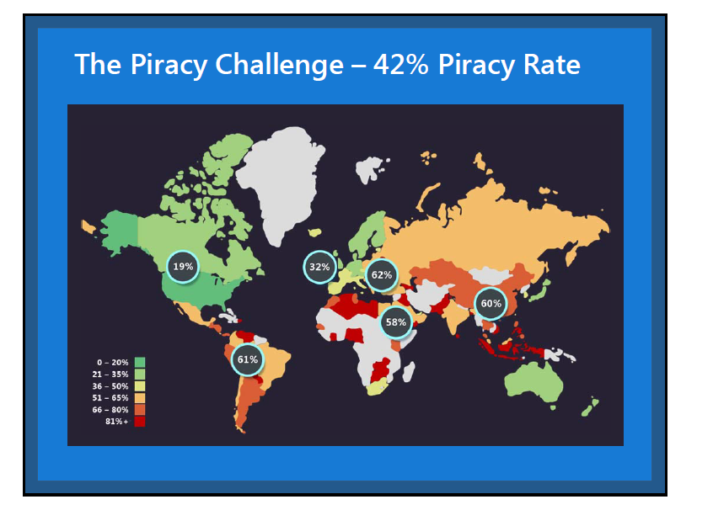
Rate of Piracy
Notes:
Eastern Europeans have the highest rate of software piracy, followed by Latin America, Asia-Pacific, and Africa. Western Europe and North America have the lowest rates of piracy.
In the BSA study, the piracy rate in Algeria is 84%, 63% in Russia, 77% in China, 72% in Thailand, 86% in Indonesia, and 88% in Venezuela. Countries with lower levels of software piracy include the United States (19%), Australia (23%), Finland (25%), Norway (27%), and Belgium (24%).
Source: Business Software Alliance, Ninth Annual BSA Global Software 2011 Piracy Study, 2011, http://globalstudy.bsa.org/2011/ (accessed November 15, 2013).

Slide 6
The Bottom Line
Software piracy is stealing, and it is treated like stealing
  Criminal penalties
    Individuals: Fines up to $93,500 and/or five years imprisonment
    Companies: Fines up to $467,500 and/or five years imprisonment
  Civil penalties are determined by the courts
Notes:
Source: Business Software Alliance, “Penalties for Illegal Software,” http://ww2.bsa.org/country/Anti-Piracy/Know%20the%20Law.aspx?sc_lang=en-AU (accessed November 15, 2013).

Slide 7
Largest Penalty
Chinese national Xiang Li got 12 years in prison for software piracy. He operated a website to distribute $100 million worth of pirated materials.
  Software and data stolen from about 200 American software manufacturers
  20 gigabytes of data and software was confidential and proprietary
  More than one-third of purchases made by Americans including small business owners, students, and government contractors
Notes:
Source: U.S. Department of Homeland Security, “Chinese national sentenced to 12 years in prison for cyber theft, piracy of over $100 million in sensitive software and proprietary data,” June 11, 2013, http://www.ice.gov/news/releases/1306/130611wilmington.htm (accessed November 15, 2013).

Slide 8
Other Negative Consequences
Negative consequences for businesses include increased exposure to malware, fines and injunctions, reputational damage, and elimination of access to U.S. import market
  Many counterfeit software comes equipped with malware, which can steal company secrets and threaten security
  Government authorities have begun investigating piracy companies for tax evasion
Notes:
The malware market is $114 billion industry.
Source:

Slide 9
Responsiblity
Individuals are responsible for their own conduct
Companies can be held liable for software piracy committed by employees on the job as well as suppliers
  Controls must be in place to ensure that suppliers are complying with software licensing agreements
Notes:
Source: Business Software Alliance, “Internet Software Piracy,” http://internet.bsa.org/ (accessed November 15, 2013).

Slide 10
Protective Measures against Piracy
Educating others about the harmful impact of piracy
Strong codes of conduct specifying compliance with company software procedures
Ensuring that suppliers use software legally
Verafirm (www.verafirm.org)
  Industry-supported portal to help companies manage their software and ensure that their software programs are licensed
Notes:
Source: Verafirm website, www.verafirm.org (accessed November 15, 2013).

